Slide 1
Learning Hubs for the Millions: Exploring Policy, Technology and Strategy
Why do we need Learning Hubs for the Millions?
Richard Hewitt
Director, UK Higher Education
Emsi Burning Glass

Slide 2


Our mission is to use labour market and skills data to inform and connect people, education, and employers, within the context of regional economies.
Notes:
I’m Richard Hewitt, Director for Higher Education in the UK for Emsi Burning Glass. Our mission is to help people make better decisions by connecting people, education and employers through labour market data while being mindful of the different shape and needs of regional economies – after all if you’re always looking at a national level, everything just aggregates up and actionable insights are lost. We provide data via research tools, dashboards and in its raw form primarily to educational institutions, governmental and economic development organisations and to large corporates and staffing organisations.

Slide 3
Why do we need Learning Hubs for the Millions?
Demand!
  Overall, employer demand for workers is growing
  Employer demand is changing
  Roles are changing
  Traditional education is not agile enough to respond
Notes:
Employer demand is growing, despite fears about automation or the impact of Covid and lockdowns on jobs and the economy. Growth rates over this decade are projected across occupations to be around 7% in the US; 4% in the UK.
Employer demand is changing. Levels of general education are becoming less important than specific skills and competencies people possess. Demand has become specific.
Roles are changing faster than the traditional education systems can respond to
Traditional learning is not typically driven by the needs of the labour market – and even when it does respond to changes, it can take years before qualified graduates or school leavers emerge.
Employers are looking to the current skills available from their workforce and don’t necessarily want to fill any gaps by taking on new workers who might have taken 4 years to develop the necessary capabilities in Education; they need to harness the experience and skills of their existing workforce and develop those to meet their needs – think about it like Just in Time theory. We don’t know what the skills needs of several years might be, though we can make some educated and evidence based assumptions, but we do know what’s needed right now. Can we respond to that quickly and effectively?

Slide 4
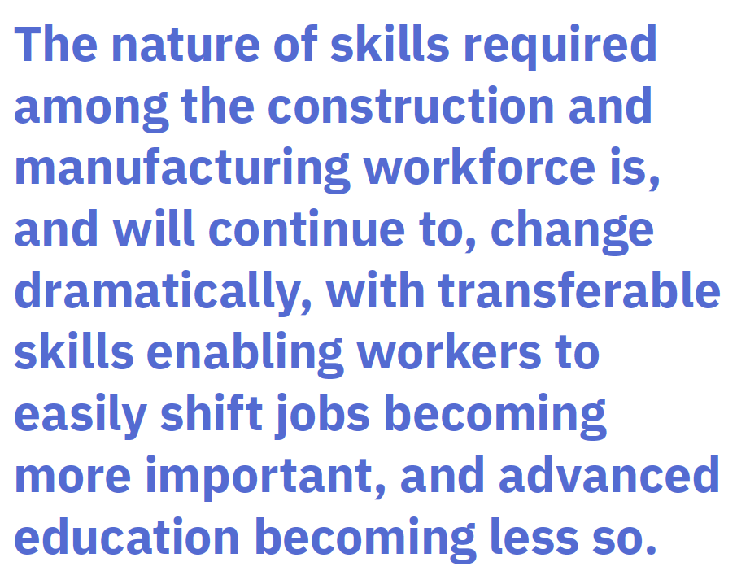
Changing employer demand
Skills Required: Emsi Burning Glass report commissioned by Autodesk
Covid accelerating digital transformation
Investment in digital initiatives
US data shows steady decline in job postings specifying a bachelors degree
Notes:
Jobs in construction and manufacturing are often at the center of the conversation when it comes to the changing nature of work. Two-thirds of construction executives believe digital transformation will only accelerate as a result of COVID-19, and 76% of manufacturing executives polled in a prior study intend to increase their investments in digital initiatives. These industries are clearly undergoing significant digital transformations.
In construction in the United States, 2020 saw a shift away from job postings requiring bachelor’s degree qualifications for the first time, while in manufacturing, most postings have been without a specified level of education since 2016. This points to the fact that employers are shifting their focus from education to skills in search of a strong employee. In the United Kingdom, 82% of job postings in construction and manufacturing didn’t require formal education in 2020. There has also been a slow and steady decline in job postings requesting a bachelor’s degree overeall since 2016 in the US.
It is critical to understand the skills and competencies most important to different sectors. This will assist workers in preparing themselves for success in the labour force and will inform firms about where they can best invest in human capital in preparation for the future.

Slide 5
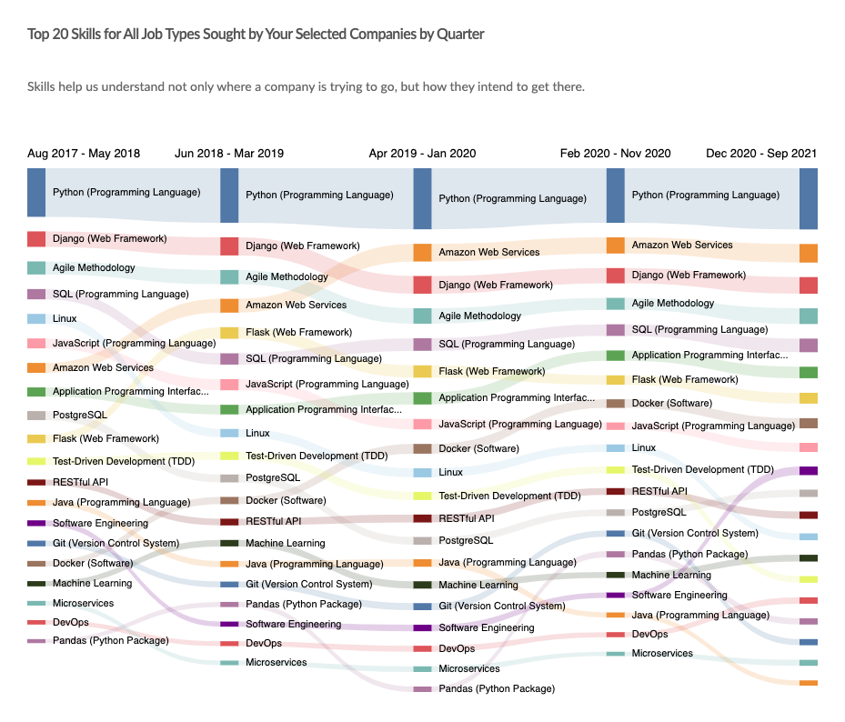
Changing roles
”Job descriptions are changing every 3 years.”
“We can’t rehire every role at that rate!”
“We not able to hire fresh grads every time to plug the skills gap”
“We need to identify the skills our employees have to map out the shortest route to reskilling and upskilling people”
Notes:
Delivering those skills to existing workforces is critical. Here are some things we here from HR directors who are pulling their hair out trying to meet the skills challenge
Job descriptions are changing too fast for us to contemplate refreshing our workforce entirely each time new skills are needed
Even if there is the opportunity to bring new skills in with new graduates or school leavers, the courses aren’t responding to what’s needed plus we want experienced people in those roles anyway.
On the right I’ve put up some data that shows how the skill shape of a Python Developer working in London has changed over the past four years in terms of hard skills. While that can be looked by an educationalist and responded to – eventually – employers need to be able to impart these skills (knowledge, attributes, competencies) as they’re required.

Slide 6



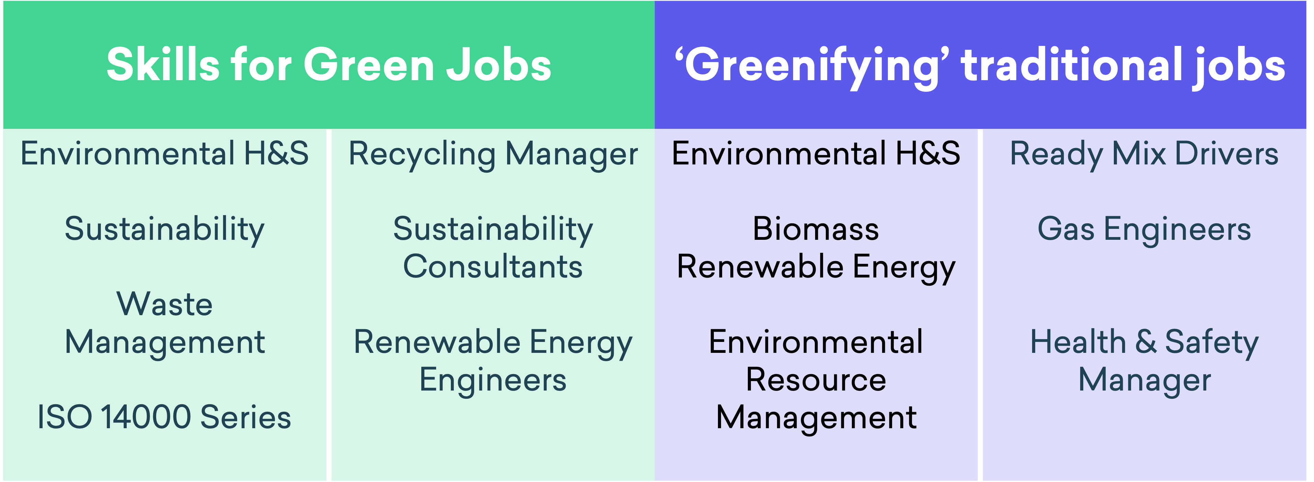
The Green Economy
Business
Jobs
Skills
Notes:
We often talk about new jobs and the new skill sets required for them. But actually change happens at the skill level first. Here we can see examples of green jobs needing green skills on the left, and on the right we can see green skills being required of traditional jobs. What happens when we put the trends side-by-side…

Slide 7
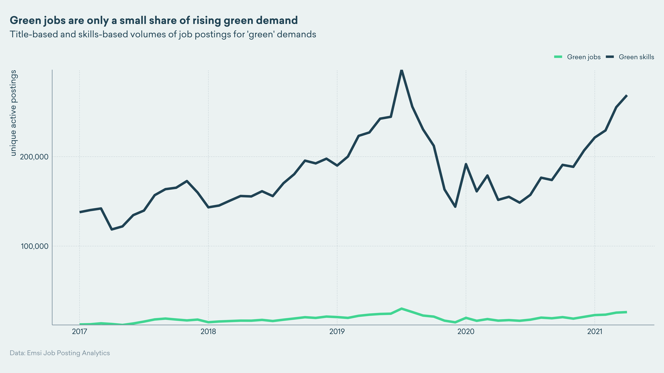
The Green Economy
Notes:
And here can see the most dramatic growth is initially seen at the skills level. The same can be seen in the tech sector with something like cybersecurity. Demand starts at the skills level and then achieves a critical mass and we can see it then emerging at the job title level.

Slide 8
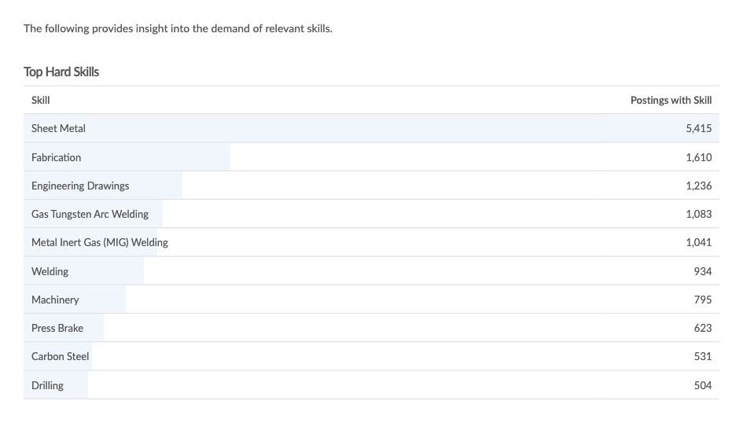
Respond to data
Job family (occupation)
Job title
Location
Employer
Hard and Soft Skills
Notes:
So how can education providers get in front of what’s needed?
What can be done is to aggregate what employers are looking for right now and seek out skills trends and respond to those.
Here we can see the aggregated skills demand for sheet metal workers. I also know where these skills are being sought: Manchester, Leeds, Bradford in the Northwest of England, and then cities and towns in England’s West Midlands region.
We need to be able to respond to what’s happening in the labour market in a way that is cognisant of skills and competencies. We are not always dealing with people exiting the education system to fill the gaps between what employers have and what they need because the gaps are occurring too quickly – a process that has been accelerated by Covid, but also by other factors like demographic shifts in some countries – from aging populations to reductions in immigration.

